Slide 1

iCare
Harmony and Convenience

Slide 2

Team Members
12301104 Lu Yunfeng 卢运烽
12301101 Li Zhe 李喆

Slide 3
Brief Introduction of this application

Slide 4
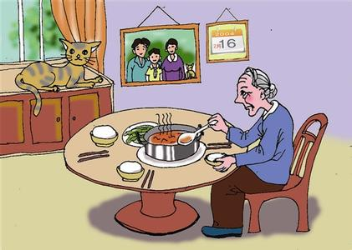
Some elders are living alone in modern China

Slide 5
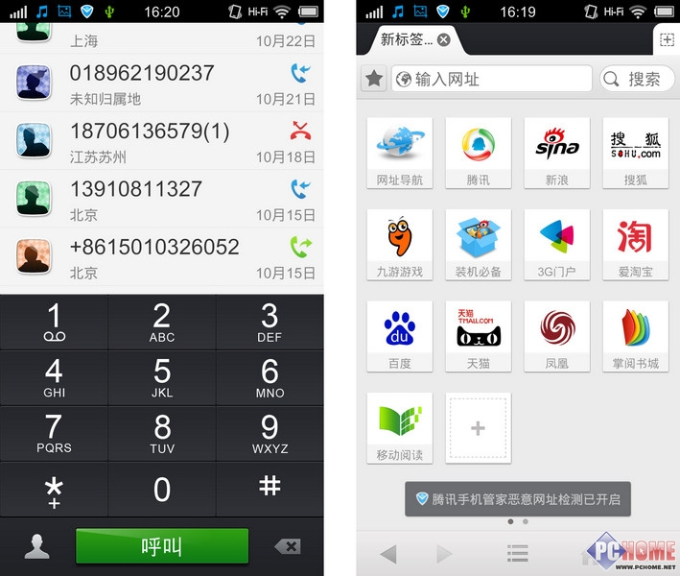

They may find it difficult to dial their children`s phone number
The Button is too small and I couldn’t memorize the phone number!

Slide 6

They may lose their way when they leave their home

Slide 7
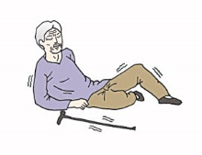
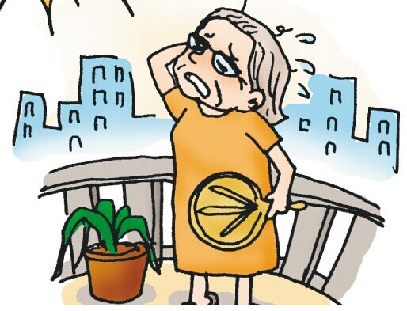
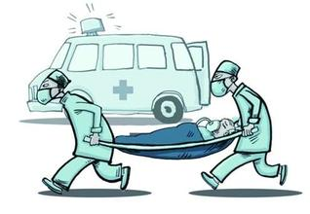
They may face danger or sudden illness

Slide 8
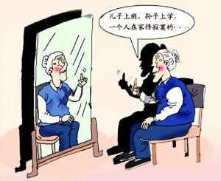
They may feel bored because of living alone
My son is working, and my grandson is in school now. I feel so bored living alone…

Slide 9
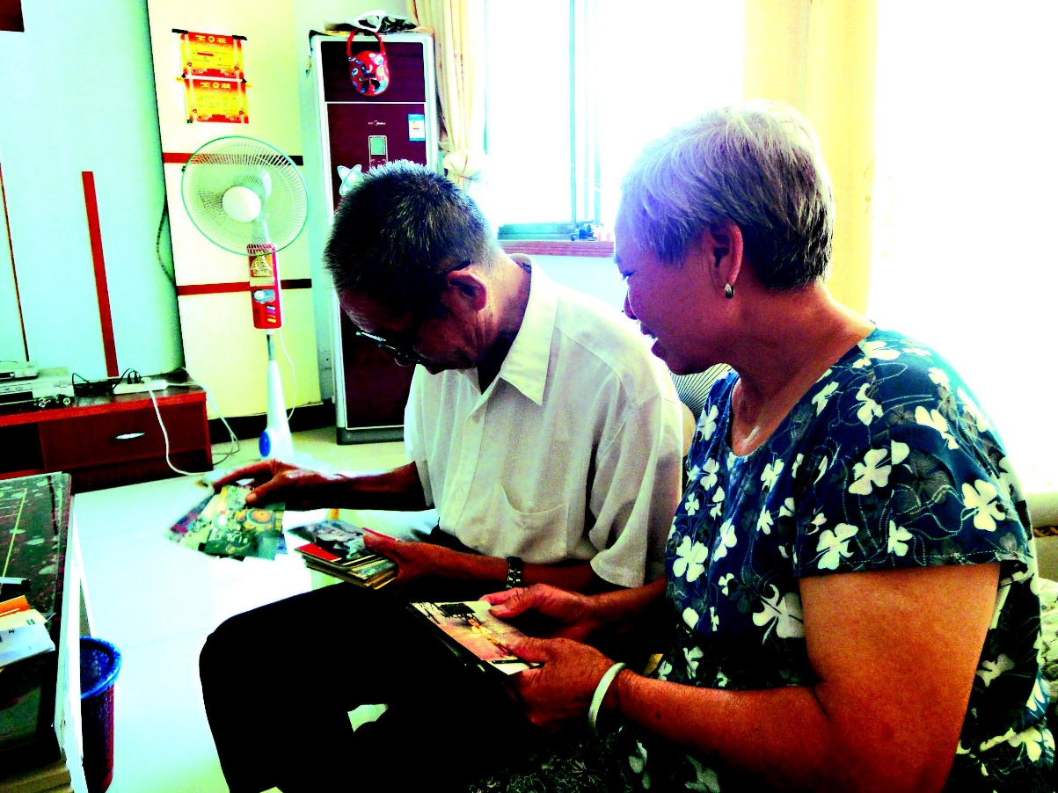
Sometimes their only need is to have a look at their children

Slide 10

Or hearing the voices of their children

Slide 11
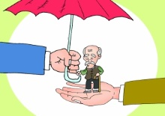
And get assistance in emergencies

Slide 12




Communication
Caring & Assistance
Information
Entertainment

Slide 13
Their needs are our working goals

Slide 14
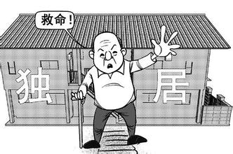

We provide services especially for
60
Old people age over
Living alone
Need caring

Slide 15

Not only the elder, but also the whole family

Slide 16
What can we do for the elder?

Slide 17
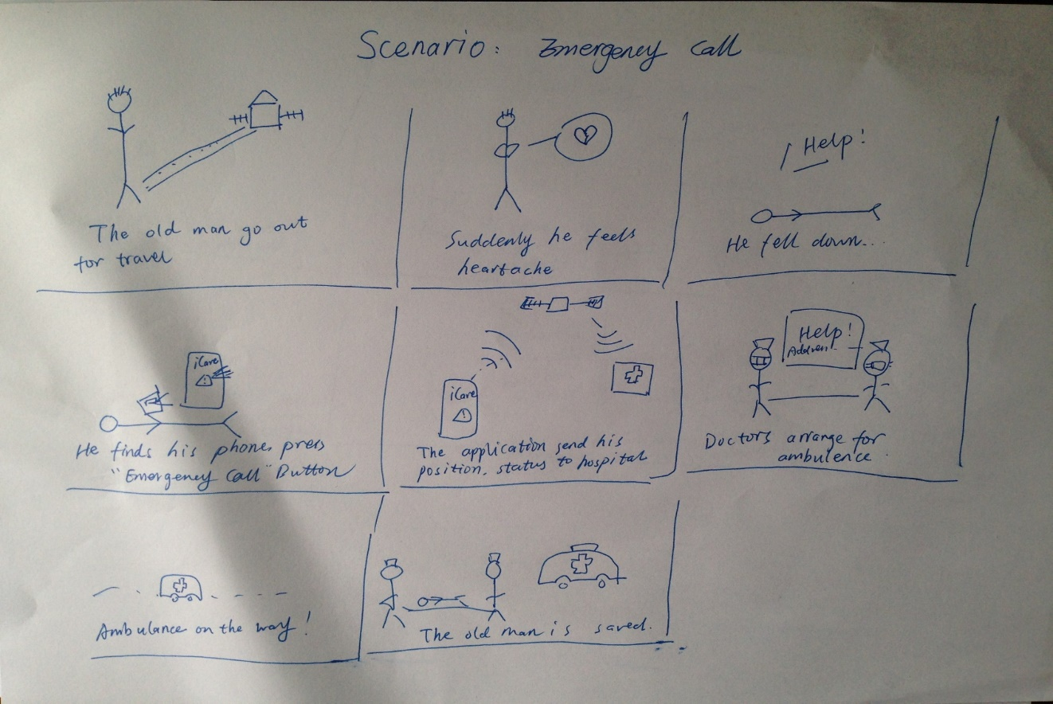
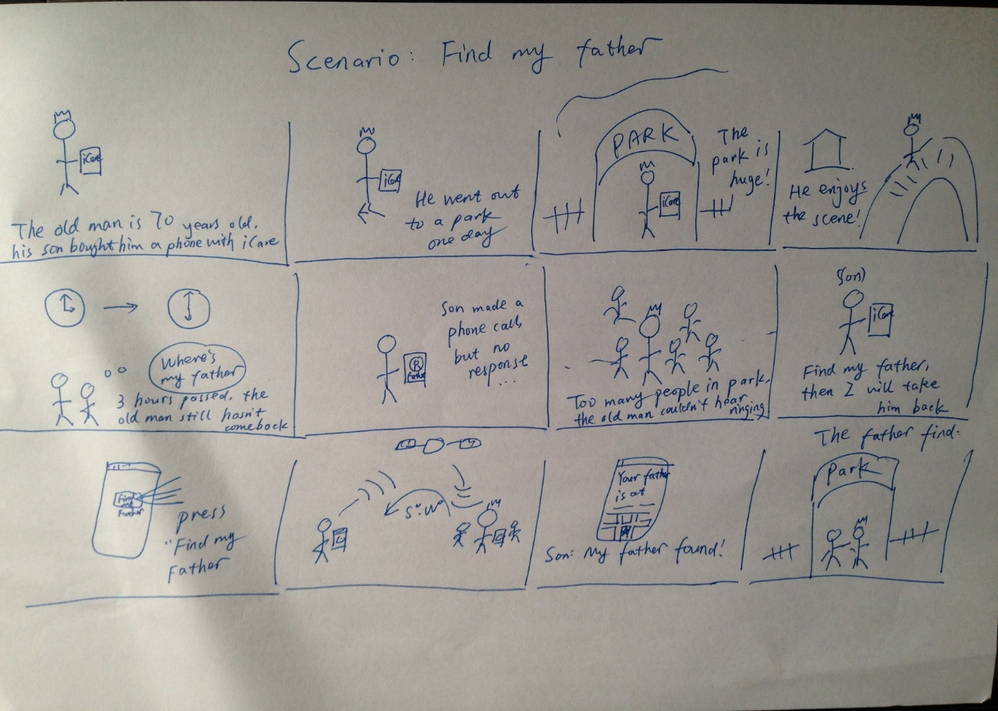
Our steps of design

Slide 18
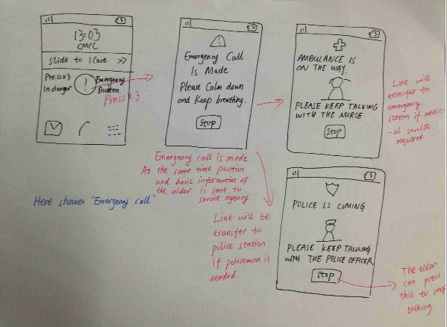
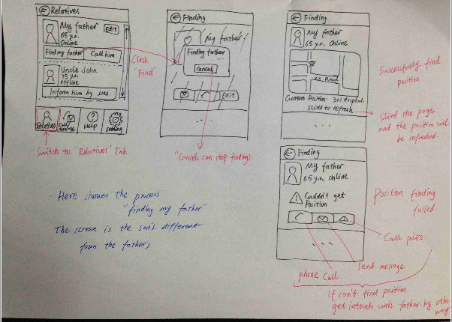
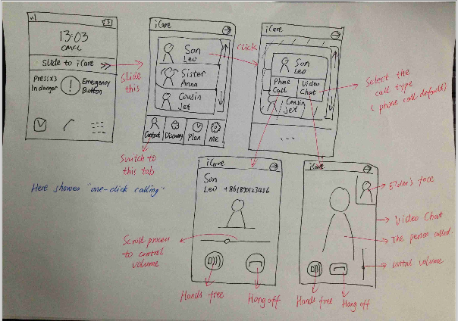

Slide 19
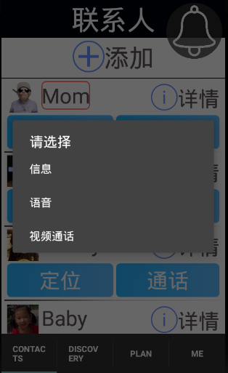
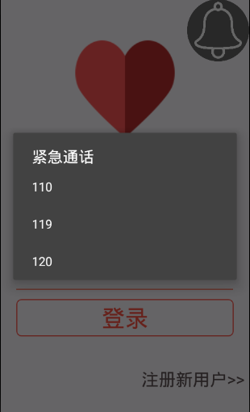
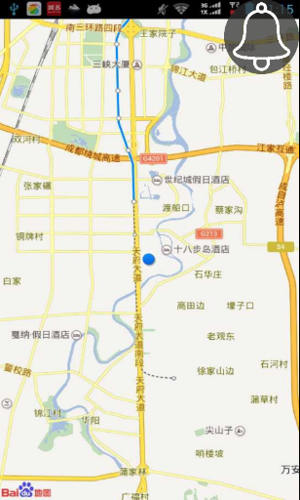
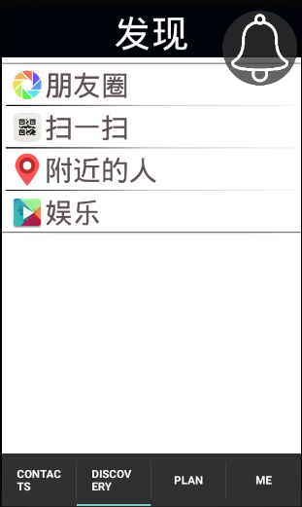
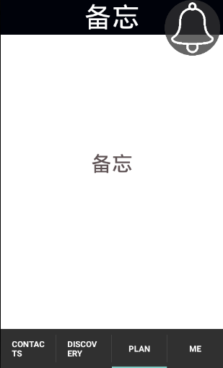
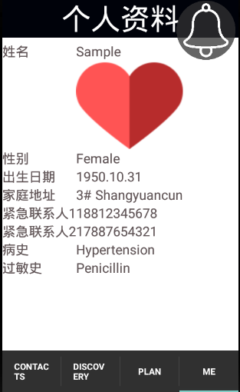
Our Main functions
One-button call
Emergency call
Location Query
Entertainment
Notes
Personal Profile
… and so on

Slide 20
Now we will show the most attractive function of our application

Slide 21

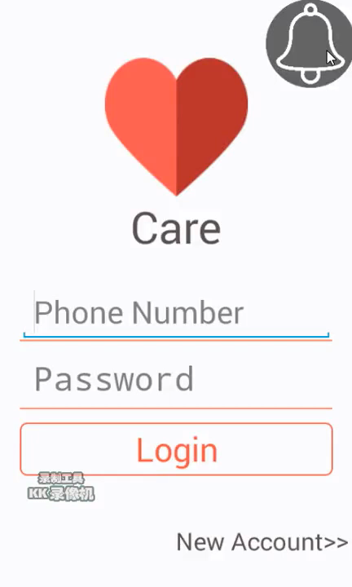
Emergency Call

Slide 22
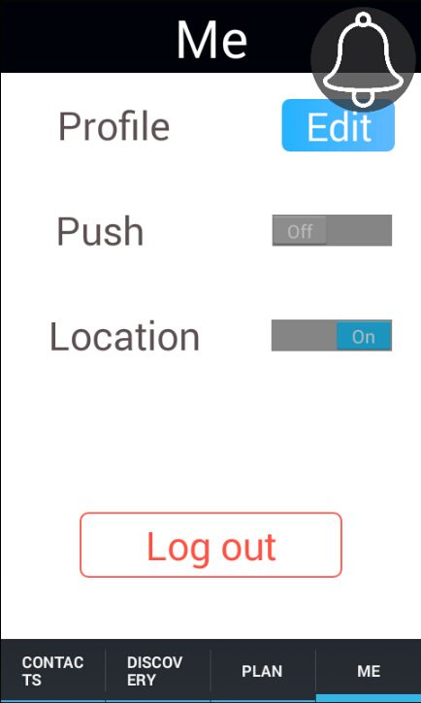
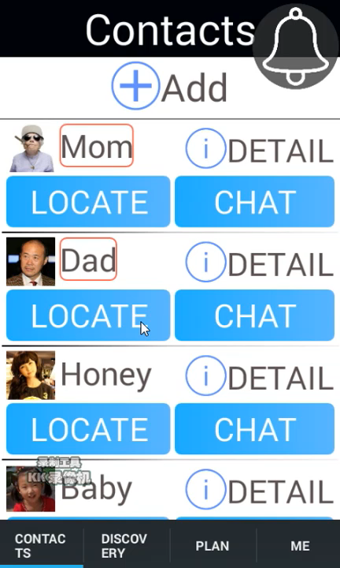
Location

Slide 23
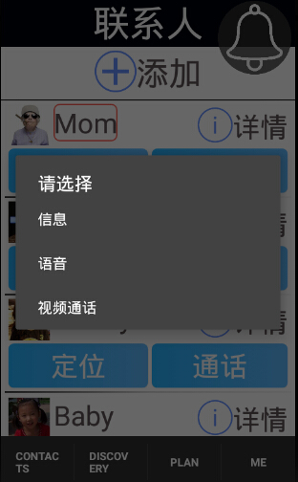
3 Kind of ways to chat

Slide 24
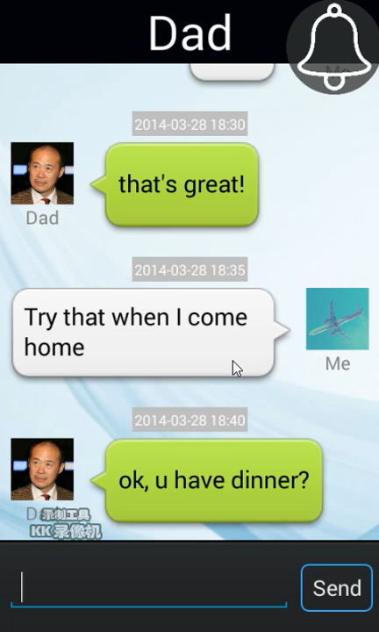
Text Messages

Slide 25
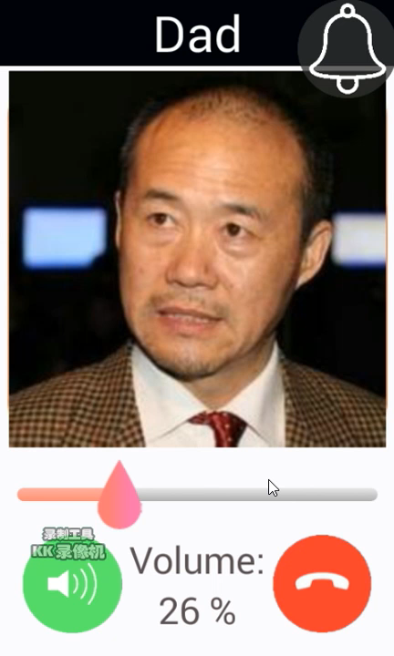
Phone Call

Slide 26
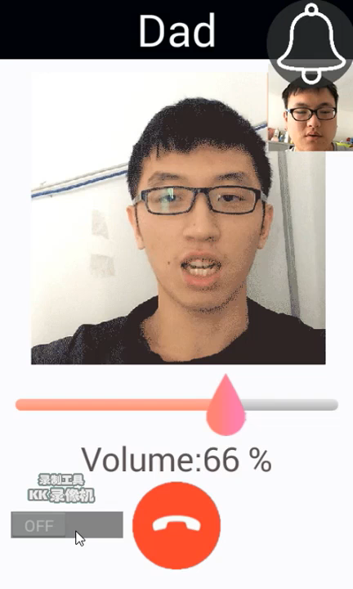
Video Call
Funny
Light
Speed

Slide 27
Future steps of our application

Slide 28

More functions will be added
-Daily Plan

Slide 29
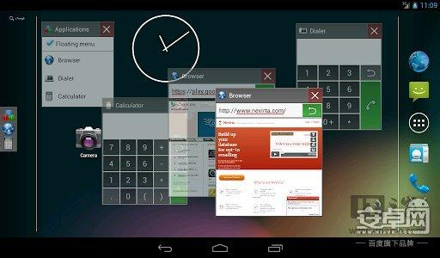
-Floating window in main screen

Slide 30
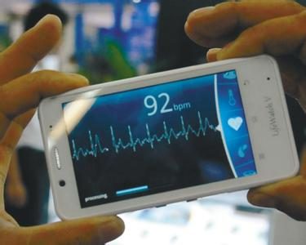
-Heartbeat/blood pressure monitoring
And so on…

Slide 31

We are dreaming to set up a social company, to afford service to the elder.

Slide 32



We will cooperate with government and hospital, link the application with public services.

Slide 33


